Slide 1
CS301 – Data Structures
Lecture No. 36
Data Structures Lecture No. 36
Reading Material
Data Structures and Algorithm Analysis in C++
Chapter. 8
8.4, 8.5, 8.6
Summary
•
•
•
•
•
•
Running Time Analysis Union by Size
Analysis of Union by Size
Union by Height Sprucing up find
Timing with Optimization
Running Time Analysis
In the previous lecture, we constructed up trees through arrays to implement disjoint sets. union and find methods along with their codes were discussed with the help of figures. We also talked about the ways to improve these methods. As far as the union operation is concerned, considering the parent array, it was related to changing the index of the array. The root value of the merging tree was put into that. In case of find, we have to go to the root node following the up pointers.
While studying the balanced trees, we had constructed a binary search tree from the already sorted data. The resultant tree becomes a linked list with height N. Similar kind of risks involved here. Suppose, we have eight members i.e.1, 2, 3, 4, 5, 6, 7 and
8 as discussed in an example in the previous lecture. Suppose their unions are
performed as union(1,2), union(2,3), union(3,4) and so on up to union(7,8). When the trees of these unions are merged together, there will be a longer tree of height 8. If we perform a find operation for an element that is present in the lowest node in the tree then N-1 links are traversed. In this particular case, 8-1=7 links.
We know that with reduced tree (with lesser height), the time required for find
operation will also be reduced. We have to see whether it is possible to reduce the size (in terms of height) of the resultant tree (formed after unions of trees). Therefore, our goal is:
Goal: Modify union to ensure that heights stay small
We had already seen this goal in the last slide of our previous lecture, which is given below in full:
union is clearly a constant-time operation.
Running time of find(i) is proportional to the height of the tree containing node i.
This can be proportional to n in the worst case (but not always)

Slide 2
CS301 – Data Structures
Lecture No. 36
Goal: Modify union to ensure that heights stay small
You might be thinking of employing the balancing technique here. But it will not be sagacious to apply it here. Due to the use of array, the ‘balancing’ may prove an error- prone operation and is likely to decrease the performance too. We have an easier and appropriate method, called Union by Size or Union by Weight.
Union by Size
Following are the salient characteristics of this method:
Maintain sizes (number of nodes) of all trees, and during union.
Make smaller tree, the subtree of the larger one.
Implementation: for each root node i, instead of setting parent[i] to -1, set it to -k if tree rooted at i has k nodes.
This is also called union-by-weight.
We want to maintain the sizes of the trees as given in the first point. Until now, we are not maintaining the size but only the parent node. If the value for parent in a node is – 1, then this indicates that the node is the root node. Consider the code of the find operation again:
// find(i):
// traverse to the root (-1)
for(j=i; parent[j] >= 0; j=parent[j])
;
return j;
The terminating condition for loop is checking for non-negative values. At any point when the value of parent[j] gets negative, the loop terminates. Note that the condition does not specify exactly the negative number. It may be the number –1, –2 , –3 or some other negative number that can cause the loop to be terminated. That means we can also put the number of nodes (size) in the tree in this place. We can put the number of nodes in a tree in the root node in the negative form. It means that if a tree consists of six nodes, its root node will be containing –6 in its parent. Therefore, the node can be identified as the root being the negative number and the magnitude (the absolute value) of the number will be the size (the number of nodes) of the tree.
When the two trees would be combined for union operation, the tree with smaller size will become part of the larger one. This will cause the reduction in tree size. That is why it is called union-by-size or union-by-weight.
Let’s see the pseudo-code of this union operation (quite close to C++ language). This contains the logic for reducing tree size as discussed above:
1.
2.
//union(i,j): root1 = find(i); root2 = find(j);

Slide 3
CS301 – Data Structures
Lecture No. 36
3.
4.
5.
6.
7.
8.
9.
10.
11.
12.
13.
14.
15.
if (root1 != root2)
if (parent[root1] <= parent[root2])
{
// first tree has more nodes parent[root1] += parent[root2]; parent[root2] = root1;
}
else
{
// second tree has more nodes parent[root2] += parent[root1]; parent[root1] = root2;
}
This operation performs the union of two sets; element i’s set and element j’s set. The first two lines are finding the roots of the sets of both the elements i.e.i and j. Line 3 is performing a check that the root1 is not equal to root2. In case of being unequal, these are merged together. In next statement (line 4), the numbers in parent variables of root nodes are compared. Note that, the comparison is not on absolute values. So the
tree with greater number of nodes would contain the lesser number mathematically. The condition at line 4 will be true, if the tree of root1 is greater in size than that of root2. In line 7, the size of the smaller tree is being added to the size of the greater one. Line 8 is containing the statement that causes the trees to merge. The parent of root2 is being pointed to root1. If the root2 tree is greater in size than the root1 tree, the if–condition at line 4 returns false and the control is transferred to else part of the if-condition. The parent of root1 (the size of the root1 tree) is added in the parent of root2 in line 13 and the root1 tree is merged into the root2 tree using the statement at line 14.
Let’s practice this approach using our previous example of array of eight elements.
1 2 3 4 5 6 7
8
-1 | -1 | -1 | -1 | -1 | -1 | -1 | -1
1 2 3 4 5 6 7 8
Eight elements, initially in different sets.
Fig 36.1
These are eight nodes containing initially –1 in the parent indicating that each tree contains only one node. Let’s unite two trees of 4 and 6. The new tree will be like the one shown in Fig 36.2.

Slide 4
CS301 – Data Structures
Lecture No. 36
1
2
3
4
5
7
8
6
Union(4,6)
-1 | -1 | -1 | -2 | -1 | 4 | -1 | -1
1
2 3 4 5
6 7 8
Fig 36.2
From the figure, you can see the node 6 has come down to node 4. The array also depicts that the parent at position 4 is containing –2. The number of nodes has become 2. The position 6 is set to 4 indicating that parent of 6 is 4. Next, we similarly perform the union operation on nodes 2 and 3.
1 2 4 5 7 8
3
6
After union(2,3)
-1 | -2 | 2 | -2 | -1 | 4 | -1 | -1
1 2 3 4
Fig 36.3
5 6 7 8
Let’s perform the union operation further and merge the trees 1 and 4.

Slide 5
CS301 – Data Structures
Lecture No. 36
2
4
5
7
8
3
1
6
union(1,4)
4 | -2 | 2 | -3 | -1 | 4 | -1 | -1
1
2 3 4 5
Fig 36.4
6 7 8
1 was a single node tree (-1 in the array at position 1) and 4 was the root node of the tree with two elements (-2 in the array at position 4) 4 and 6. As the tree with root 4 is greater, therefore, node 1 will become part of it. Previously (when the union was not
based on weight), it happened contrary to it with second argument tree becoming the part of the first tree.
In this case, the number of levels in the tree still remains the same (of two levels) as
that in the greater tree (with root 4). But we apply our previous logic i.e. the number of levels of the trees would have been increased from two to three after the union. Reducing the tree size was our goal of this approach.
In the next step, we merge the trees of 2 and 4. The size of the tree with root 2 is 2 (actually –2 in the parent array) while the size of the tree with root 4 is 3 (actually –3). So the tree of node 2 will be joined in the tree with root 4.
4 5 7 8
2
1
6
3
union(2,4)
1 2 3 4 5 6 7 8
Fig 36.5
The latest values in the array i.e. at position 4, have been updated to –5 (indicating the size of the tree has reached 5). At position 2, the new value is 4, which indicates that the up node of 2 is 4.
4 | 4 | 2 | -5 | -1 | 4 | -1 | -1

Slide 6
CS301 – Data Structures Lecture No. 36
Next, we perform the union(5,4) operation. We know that the size of the tree with node 4 is 5 (-5 in the array) and node 5 is single node tree. As per our rules of union by size, the node 5 will become part of the tree 4.
4
7
8
2
1
6
5
union(5,4)
4 | 4 | 2 | -6 | 4 | 4 | -1 | -1
3
1
2 3 4 5
Fig 36.6
6 7 8
The updates inside the array can be seen as the value at position 4 has been changed to –6 and new value at position 5 is 4. This is the tree obtained after applying the
union-by-size approach. Consider, if we had applied the previous method of union,
tree’s depth would have been increased more.
It seems that we have achieved our goal of reducing the tree size up to certain extent. Remember, the benefit of reducing the tree height is to increase performance while finding the elements inside the tree.
Analysis of Union by Size
If unions are done by weight (size), the depth of any element is never greater than log₂n.
By following the previous method of union where second tree becomes the part of the first tree, the depth of the tree may extend to N. Here N is the number of nodes in the tree. But if we take size into account and perform union by size, the depth of tree is log₂n maximum. Suppose the N is 100,000 i.e.for 100,000 nodes. The previous
methods may give us a tree with depth level as 100,000. But on the other hand, log₂100000 is approximately 20.Union-by-size gives us a tree of 20 levels of depth maximum. So this is a significant improvement.
Mathematical proof of this improvement is very complex .We are not covering it here but only providing the logic or reasoning in intuitive proof.
Intuitive Proof:

Slide 7
CS301 – Data Structures
Lecture No. 36
Initially, every element is at depth zero.
When its depth increases as a result of a union operation (it’s in the smaller tree), it is placed in a tree that becomes at least twice as large as before (union of two equal size trees).
How often can each union be carried out? -- log₂n times, because after at most
log₂n unions, the tree will contain all n elements.
Union by Height
Alternative to union-by-size strategy: maintain heights,
During union, make a tree with smaller height a subtree of the other.
Details are left as an exercise.
This is an alternate way of union-by-size that we maintain heights of the trees and join them based on their heights. The tree with smaller height will become part of the one with greater height. This is quite similar with the union-by-size. In order to implement Disjoint Set ADT, any of these solutions can work. Both the techniques i.e. union-by- size and union-by-height are equivalent, although, there are minor differences when analyzed thoroughly.
Now, let’s see what can we do for find operation to make it faster.
Sprucing up Find
So far we have tried to optimize union.
Can we optimize find?
Yes, it can be achieved by using path compression (or compaction).
Considering performance, we can optimize the find method. We have already optimized the trees union operation and now we will see how can optimize the find operation using the path compression.
During find(i), as we traverse the path from i to root, update parent entries for all these nodes to the root.
This reduces the heights of all these nodes.
Pay now, and reap the benefits later!
Subsequent find may do less work.
To understand the statements above, let’s see the updated code for find below:
find (i)
{
if (parent[i] < 0)
return i;
else
return parent[i] = find(parent[i]);

Slide 8
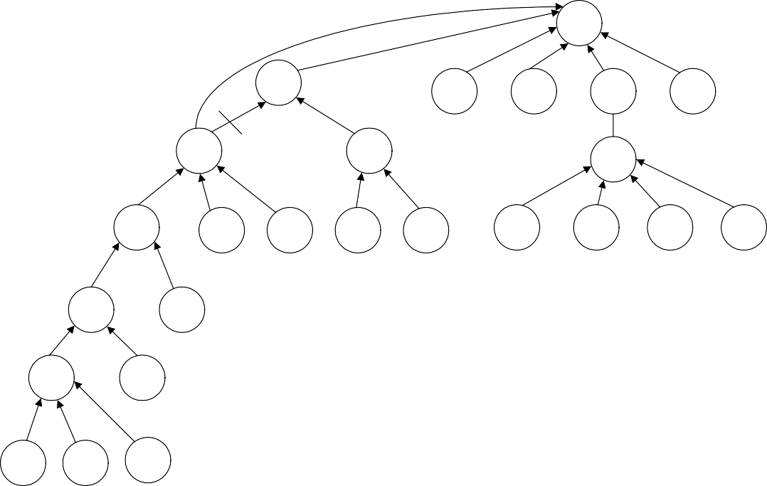
CS301 – Data Structures
Lecture No. 36
}
We have modified the code in the body of the find. This implementation is of recursive nature. parent[i] negative means that we have reached the root node. Therefore, we are returning i. If this is not the root node, then find method is being called recursively. We know that parent[i] may be positive or negative. But in this case it will not be negative due to being an index. To understand this recursive call, we elaborate it further with the help of figure. We call the find method with argument 1.
7
13
8
3
22
6
4
5
10
9
31
32
11
30
20
16
14
12
2
35
Find (1)
1
13
17
18
19
Fig 36.7
This tree is bigger as compared to the ones in our previous examples, it has been constructed after performing some union operations on trees. Now we have called find method with argument 1. We want to find the set with node 1. By following the previous method of find, we will traverse the tree from 1 to 2, from 2 to 9, 9 to 4, 4 to 13 and finally from 13 to 7, which is the root node, containing the negative number. So the find will return 7.
If we apply recursive mechanism given in the above code, the recursive call will start
from find(1). The parent (find(1)) will return 2. The recursive call for 2 will take the control to node 9, then to 4, 13 and then eventually to 7. When find(7) is called, we get the negative number and reach the recursion stopping condition. Afterwards, all the recursive calls, on the stack are executed one by one. The call for 13, find(13) returns 7. find(4) returns 7 because find(parent(4)) returns 7. That is why the link between 4 and 13 has been dropped and a new link is established between 4 and 7 as shown in the Fig 36.7. So the idea is to make the traversal path shorter from a node to the root. The remaining recursive calls will also return 7 as the result of find operation. Therefore, for subsequent calls we establish the links directly from the node to the root.

Slide 9
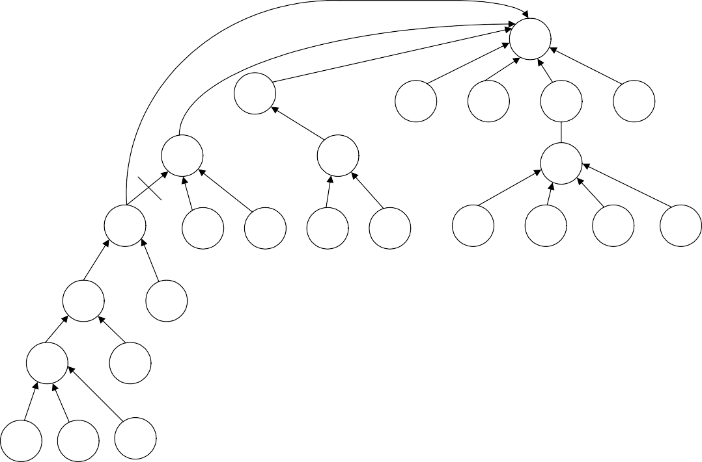
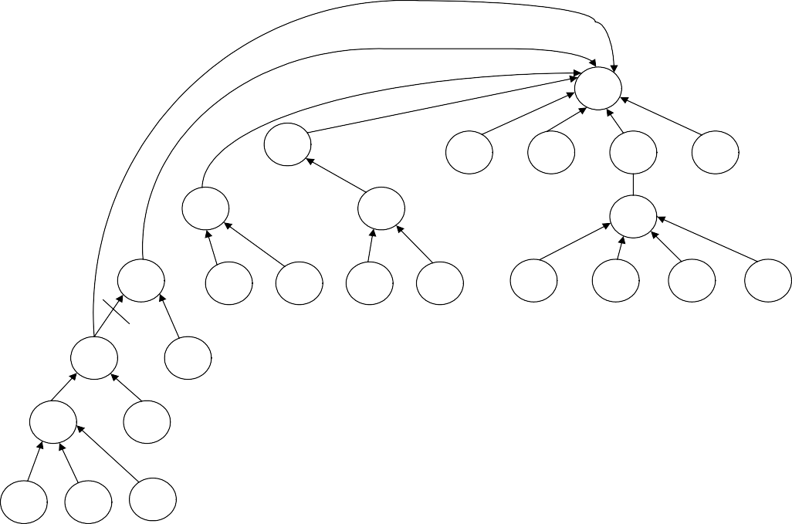
CS301 – Data Structures
Lecture No. 36
7
13
8
3
22
6
4
5
10
9
31
32
11
30
20
16
14
12
2
35
Find (1)
1
13
17
18
19
Fig 36.8
Similarly the node 2 is directly connected to the root node and the interlink between the node 2 and 9 is dropped.
7
13
8
3
22
6
4
5
10
9
31
32
11
30
20
16
14
12
2
35
Find (1)
1
13
17
18
19
Fig 36.9
The same will happen with 1.

Slide 10
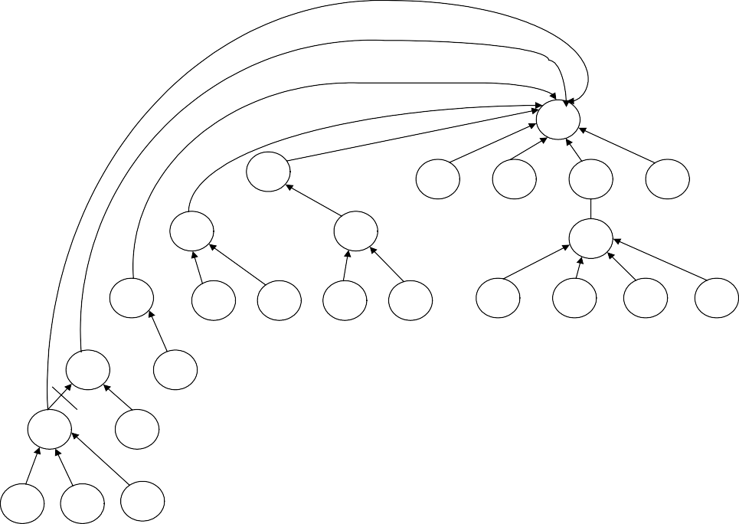
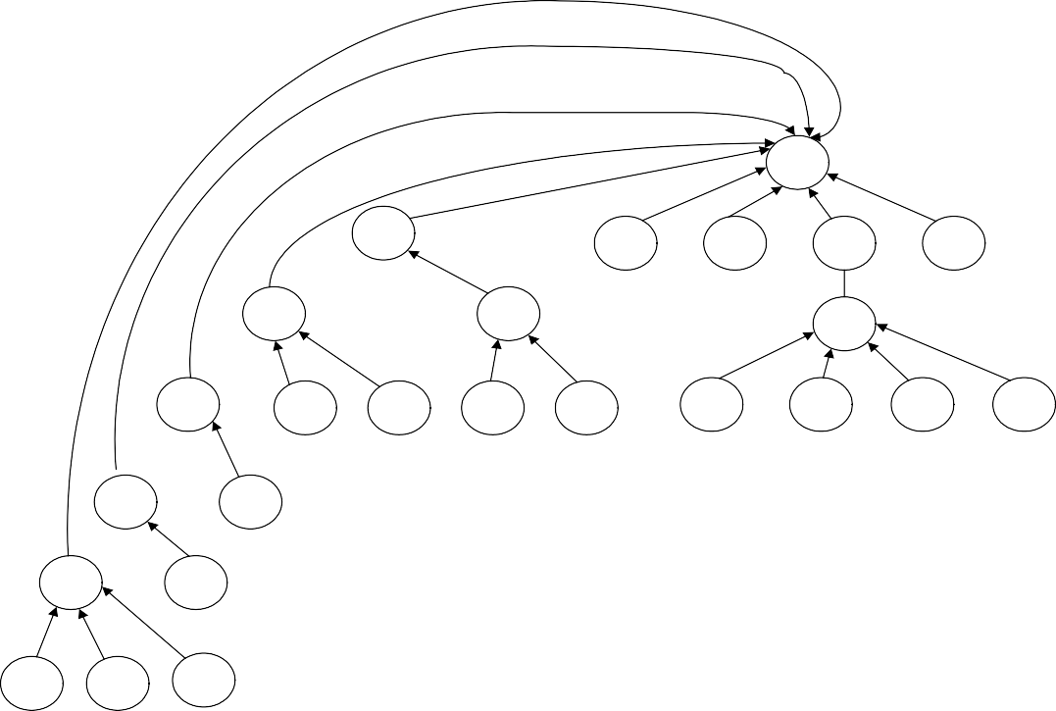
CS301 – Data Structures
Lecture No. 36
7
13
8
3
22
6
4
5
10
9
31
32
11
30
20
16
14
12
2
35
Find (1)
1
13
17
18
19
Fig 36.10
7
13
8
3
22
6
4
5
10
9
31
32
11
30
20
16
14
12
2
35
Find (1 )
1
13
17
18
19
Fig 36 .11
The union operation is based on size or weight but the reducing the in-between links or path compression from nodes to the root is done by the find method. The find method will connect all the nodes on the path to the root node directly.
The path compression is depicted by the following tree:

Slide 11
CS301 – Data Structures
Lecture No. 36
f
e
d
Find(a)
c
b
a
Fig 36.12
If we have called find(a) then see the path from node a to the root node f. a is connected to root node f through b, c, d and e nodes. Notice that there may be further subtrees below these nodes. After we apply this logic of path compression for find operation, we will have the tree as follows:
f
Find(a)
a
b
c
d
e
Fig 36.13
We see, how much is the impact on performance in find by a theorem.
Timing with Optimization
Theorem: A sequence of m union and find operations, n of which are find operations, can be performed on a disjoint-set forest with union by rank (weight or height) and path compression in worst case time proportional to (mÑ (n)).
Ñ(n) is the inverse Ackermann’s function which grows extremely slowly. For all

Slide 12
CS301 – Data Structures Lecture No. 36
practical purposes, Ñ(n) R 4.
Union-find is essentially proportional to m for a sequence of m operations, linear in m.
There are number of things present in this theorem regarding analysis, which are
difficult to cover in this course. We sill study these in course of Algorithm Analysis. At the moment, consider if there are m union operations out of which n are finds. The average time for union-find will be linear in m and it will grow not quadratically or exponentially. union and find operations using this data structure are very efficient regarding both space and time.

Slide 13
CS301 – Data Structures
Lecture No. 37
Data Structures Lecture No. 37
Reading Material
Data Structures and Algorithm Analysis in C++
Chapter. 8
Summary
•
•
•
•
Review
Image Segmentation Maze Example
Pseudo Code of the Maze Generation
Review
In the last lecture, we talked about union and find methods with special reference to the process of optimization in union. These methods were demonstrated by reducing size of tree with the help of the techniques-union by size or union by weight. Similarly the tree size was reduced through path optimization in the find method. This was due to the fact that we want to reduce the tree traversal for the find method. The time required by the find/union algorithm is proportional to m. If we have m union and n find, the time required by find is proportional to m+n. Union is a constant time operation. It just links two trees whereas in the find method tree traversal is involved. The disjoint sets are increased and forest keeps on decreasing. The find operation takes more time as unions are increased. But on the average, the time required by find is proportional to m+n.
Now we will see some more examples of disjoint sets and union/find methods to understand their benefits. In the start, it was told that disjoint sets are used in image segmentation. We have seen the picture of a boat in this regard. We have also talked about the medical scanning to find the human organs with the help of image segmentation. Let’s see the usage of union/find in image segmentation.
Image segmentation is a major part of image processing. An image is a collection of pixels. A value associated with a pixel can be its intensity. We can take images by cameras or digital cameras and transfer it into the computer. In computer, images are represented as numbers. These numbers may represent the gray level of the image. The zero gray level may represent the black and 255 gray level as white. The numbers between 0 and 255 will represent the gray level between black and white. In the color images, we store three colors i.e. RGB (Red, Green, Blue). By combining these three colors, new ones can be obtained.
Image Segmentation
In image segmentation, we will divide the image into different parts. An image may

Slide 14
CS301 – Data Structures Lecture No. 37
be segmented with regard to the intensity of the pixels. We may have groups of pixels having high intensity and those with pixels of low intensity. These pixels are divided on the basis of their threshold value. The pixels of gray level less than 50 can be combined in one group, followed by the pixels of gray level less between 50 and 100 in another group and so on. The pixels can be grouped on the basis of threshold for difference in intensity of neighbors. There are eight neighbors of the pixel i.e. top, bottom, left, right, top-left, top-right, bottom-left and bottom-right. Now we will see the difference of the threshold of a pixel and its neighbors. Depending on the difference value, we will group the pixels. The pixels can be grouped on the basis of texture (i.e. a pattern of pixel intensities). You will study all these in detail in the image processing subject.
Let’s see an example. Consider the diagram below:
It seems a sketch or a square of black, gray and white portions. These small squares represent a pixel or picture element. The color of these picture elements may be white, gray or black. It has five rows and columns each. This is a 5 * 5 image. Now we will have a matrix of five rows and five columns. We will assign the values to the elements in the matrix depending on their color. For white color, we use 0, 4 for black and 2 for gray color respectively.
 | 0 | 1 | 2 | 3 | 4
0 | 0 | 0 | 0 | 4 | 4
1 | 2 | 0 | 4 | 4 | 0
2 | 4 | 2 | 2 | 4 | 4
3 | 4 | 4 | 0 | 4 | 4
4 | 0 | 2 | 2 | 4 | 0
When we get the image from a digital device, it is stored in numbers. In the above matrix, we have numbers from 0 to 4. These can be between 0 and 255 or may be
more depending upon the digital capturing device. Now there is a raw digital image. We will apply some scheme for segmentation. Suppose we need the pixels having value 4 or more and the pixels with values less than 4 separately. After finding such
pixels, put 1 for those that have values more than 4 and put 0 for pixels having less than 4 values. We want to make a binary array by applying the threshold. Let’s apply this scheme on it.
0 1 2 3 4

Slide 15
CS301 – Data Structures |  |  |  |  | Lecture No. 3
 | 0 | 0 | 0 | 0 | 1 1
 | 1 | 0 | 0 | 1 | 1 0
 | 2 | 1 | 0 | 0 | 1 1
 | 3 | 1 | 1 | 0 | 1 1
 | 4 | 0 | 0 | 0 | 1 0
7
We have applied threshold equal to 4. We have replaced all 4’s with 1 and all the values less than 4, have been substituted by zero. Now the image has been converted into a binary form. This may represent that at these points, blood is present or not.
The value 4 may represent that there is blood at this point and the value less than 4 represents that there is no blood. It is very easy to a program for this algorithm.
Our objective was to do image segmentation. Suppose we have a robot which captures an image. The image obtained contains 0, 2 and 4 values. To know the values above and below the threshold, it may use our program to get a binary matrix. Similarly, for having the knowledge regarding the region of 1’s and region of 0’s, the robot can use the algorithm of disjoint sets. In the figure above, you can see that most of the 1’s are on the right side of the matrix.
We will visit each row of the matrix. So far, there are 25 sets containing a single element each. Keep in mind the example discussed in union/find algorithm. In the zeroth row, we have three 0’s. We can apply union on 0’s. Yet we are interested in 1’s. In the 3rd column, there is an entry of 1. Now the left neighbor of this element is 0 so we do not apply union here and move to the next column. Here, the entry is 1. Its left neighbor is also 1. We apply union here and get a set of two elements. We have traversed the first row completely and moved to the next row. There is 0 in the 0th and 1st column while in the 2nd column; we have an entry of 1. Its left neighbor is 0 so we move to the next column where entry is also 1. We apply union here. There is a set of 1 at the top of this set also. So we take union of these two sets and combine them. There is a set of four 1’s, two from row 0 and two from row 1. In the next row, we have 1, 0, 0, 1, 1. In the row 2 column 3, there is 1. At the top of this element, we have 1. We apply union to this 1 and the previous set of four 1’s. Now we have a set of five 1’s. In the next column again, there is 1, also included in the set as the sixth element. In the row 3, we have 1 at the 0 column. There is 1 at the top of this so we have set of these two 1’s. The next element at the row 3 is again 1, which is included in the left side set of 1’s. Now we have another set of 1’s having 3 elements. The 1’s at column 3 and column 4 are included in the set of six 1’s making it a set of eight elements. In the last row, we have single 1 at the column 3 which will be included with the eight element set. So there are two sets of 1’s in this matrix.
 | 0 | 1 | 2 | 3 | 4
0 | 0 | 0 | 0 | 1 | 1
1 | 0 | 0 | 1 | 1 | 0
2 | 1 | 0 | 0 | 1 | 1
3 | 1 | 1 | 0 | 1 | 1
4 | 0 | 0 | 0 | 1 | 0
We have two disjoint sets and it is clearly visible that where are the entries of 1’s and 0’s. This is the situation when we have set the threshold of 4 to obtain a binary image. We can change this threshold value.

Slide 16
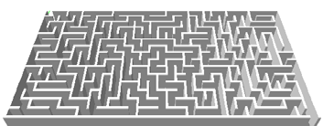
CS301 – Data Structures
Lecture No. 37
Let’s take the value 2 as threshold value. It means that if the value of pixel is 2 or more than 2, replace it by 1 otherwise 0. The new image will be as:
 | 0 | 1 | 2 | 3 | 4
0 | 0 | 0 | 0 | 1 | 1
1 | 1 | 0 | 1 | 1 | 0
2 | 1 | 1 | 1 | 1 | 1
3 | 1 | 1 | 0 | 1 | 1
4 | 0 | 1 | 1 | 1 | 0
We can apply the union scheme on it to find the region of 1’s. Here we have a blob of 1.
 | 0 | 1 | 2 | 3 | 4
0 | 0 | 0 | 0 | 1 | 1
1 | 1 | 0 | 1 | 1 | 0
2 | 1 | 1 | 1 | 1 | 1
3 | 1 | 1 | 0 | 1 | 1
4 | 0 | 1 | 1 | 1 | 0
The region is shaded. The image has been segmented. With the help of union/find algorithm, we can very quickly segment the image. The union/find algorithm does not require much storage. Initially, we have 25 sets that are stored in an array i.e. the up-
tree. We do all the processing in this array without requiring any extra memory. For the image segmentation, disjoint sets and union-find algorithm are very useful. In the image analysis course, you will actually apply these on the images.
Maze Example
You have seen the maze game in the newspapers. This is a puzzle game. The user enters from one side and has to find the path to exit. Most of the paths lead to blind alley, forcing the user to go back to square one.
This can be useful in robotics. If the robot is in some room, it finds its path between the different things. If you are told to build mazes to be published in the newspaper, a new maze has to be developed daily. How will you do that? Have you done like this before? Did anyone told you to do like this? Now you have the knowledge of disjoint sets and union-find algorithm. We will see that the maze generation is very simple with the help of this algorithm.
Let’s take a 5 * 5 grid and generate a 5 * 5 maze. A random maze generator can use union-find algorithm. Random means that a new maze should be generated every time.

Slide 17
CS301 – Data Structures
Lecture No. 37
Consider a 5x5 maze:
0 | 1 | 2 | 3 | 4
5 | 6 | 7 | 8 | 9
10 | 11 | 12 | 13 | 14
15 | 16 | 17 | 18 | 19
20 | 21 | 22 | 23 | 24
Here we have 25 cells. Each cell is isolated by walls from the others. These cells are numbered from 0 to 24. The line between 0 and 1 means that there is a wall between them, inhibiting movement from 0 to 1. Similarly there is a wall between 0 and 5. Take the cell 6, it has walls on 4 sides restricting to move from it to anywhere. The internal cells have walls on all sides. We will remove these walls randomly to establish a path from the first cell to the last cell.
This corresponds to an equivalence relation i.e. two cells are equivalent if they can be reached from each other (walls been removed so there is a path from one to the other). If we remove the wall between two cells, then there can be movement from one cell to the other. In other way, we have established an equivalence relationship between them. This can be understood from the daily life example that when the separation wall of two persons is removed, they become related to each other. In maze generation, we will remove the walls, attaching the cells to each other in some sequence. In the end, we will have a path from the start cell to the end cell.
First of all, we have to decide an entrance and an exit. From the entrance, we will move into the maze and have to reach at the exit point. In our example, the entrance is from the cell 0 and the exit will be at cell 24.
€
0 | 1 | 2 | 3 | 4
5 | 6 | 7 | 8 | 9
10 | 11 | 12 | 13 | 14
15 | 16 | 17 | 18 | 19
20 | 21 | 22 | 23 | 24
€
How can we generate maze? The algorithm is as follows:
Randomly remove walls until the entrance and exit cells are in the same set.
Removal of the wall is the same as doing a union operation.
Do not remove a randomly chosen wall if the cells it separates are already in the same set.
We will take cells randomly. It means that the probability of each cell is equal. After selecting a cell, we will choose one of its surrounding walls. The internal cells have four walls around them. Now we will randomly choose one wall. In this way, we will choose the neighboring cell. Initially we have 25 sets. Now after removing a wall between 2 cells, we have combined these two cells into one set. Here the union method has been applied to combine these two cells. If these cells are already in the same set, we will do nothing.

Slide 18
CS301 – Data Structures
Lecture No. 37
We will keep on randomly choosing the cells and removing the walls. The cells will merge together. The elements of the set will keep on growing and at some point, we may have the entrance cell (cell 0) and the exit cell (cell 24) in the same set. When the
entrance cell and the exit cell are in the same set, it means that we have a set in which the elements are related to each other and there is no wall between them. In such a situation, we can move from start to the end going through some cells of this set. Now we have at least one path from entrance to exit. There may be other paths in which we have the entrance cell but not the exit. By following this path, you will not reach at the exit as these paths take you to the dead end. As these are disjoint sets, so unless the entrance and exit cell are in the same set, you will not be able to find the solution of the maze.
Pseudo Code of the Maze Generation
Let’s take a look at the pseudo code of the maze generation. We will pass it to the size argument to make a maze of this size. We will use the entrance as 0 and exit as size-1 by default.
MakeMaze(int size) {
entrance = 0; exit = size-1;
while (find(entrance) != find(exit)) { cell1 = randomly chosen cell
cell2 = randomly chosen adjacent cell
if (find(cell1) != find(cell2) {
knock down wall between cells union(cell1, cell2)
}
}
}
After initializing the entrance and exit, we have a while loop. The loop will keep on executing till the time the find(entrance) is not equal to find(exit). It means that the loop will continue till the set returned by the find(entrance) and find(exit) are not same. When the entrance and exit cells are in the same set, the loop will stop. If these cells are not in the same set, we will enter into the loop. At first, we will randomly choose a cell from the available cells e.g. from 0 to 24 from our example. We are not discussing here how to randomly choose a cell in C++. There may be some function available to do this. We store this value in the variable cell1 and choose randomly its neighboring cell and store it in cell2. This cell may be its top, bottom, left or right cell, if it is internal cell. If the cell is at the top row or top bottom, it will not have four neighbors. In case of being a corner cell, it will have only two neighboring cells. Then we try to combine these two cells into one set. We have an if statement which checks that the set returned by find(cell1) is different than the set returned by find(cell2). In this case, we remove the wall between them. Then we apply union on these two cells to combine them into a set.
We randomly choose cells. By applying union on them, the sets are joined together and form new sets. This loop will continue till we have a set which contains both entrance and exit cell. This is a very small and easy algorithm. If we have the union- find methods, this small piece of code can generate the maze. Let’s take a pictorial

Slide 19
CS301 – Data Structures Lecture No. 37
look at different stages of maze generation. You can better understand this algorithm with the help of these figures. We are using the disjoint sets and union-find algorithm to solve this problem.
Initially, there are 25 cells. We want to generate a maze from these cells.
€
0 | 1 | 2 | 3 | 4
5 | 6 | 7 | 8 | 9
10 | 11 | 12 | 13 | 14
15 | 16 | 17 | 18 | 19
20 | 21 | 22 | 23 | 24
€
Apply the algorithm on it. We randomly choose a cell. Suppose we get cell 11. After this, we randomly choose one of its walls. Suppose we get the right wall. Now we will have cell 11 in the variable cell1 and cell 12 in the variable cell2.
€
0 | 1 | 2 | 3 | 4
5 | 6 | 7 | 8 | 9
10 | 11 12 |  | 13 | 14
15 | 16 | 17 | 18 | 19
20 | 21 | 22 | 23 | 24
€
By now, each cell is in its own set. Therefore find(cell 11) will return set_11 and find(cell 12) will return set_12. The wall between them is removed and union is applied on them. Now we can move from cell 11 to cell 12 and vice versa due to the symmetry condition of disjoint sets. We have created a new set ( set_11 = {11,12} ) that contains cell 11 and cell 12 and all other cells are in their own cells.
€
0 | 1 | 2 | 3 | 4
5 | 6 | 7 | 8 | 9
10 | 11 12 |  | 13 | 14
15 | 16 | 17 | 18 | 19
20 | 21 | 22 | 23 | 24
€
Now we randomly choose the cell 6 and its bottom wall. Now the find(cell 6) will return set_6. The find(cell 11) will return set_11 which contains cell 11 and cell 12. The sets returned by the two find calls are different so the wall between them is removed and union method applied on them. The set set_11 now contains three elements cell 11, cell 12 and cell 6. These three cells are joined together and we can move into these cells.
Now we randomly select the cell 8. This cell is not neighbor of set_11 elements. We can randomly choose the cell 6 again and its bottom wall. However, they are already in the same set so we will do nothing in that case. We randomly choose the cell 8 and its top wall (cell 3). As these two cells are in different sets, the wall between them is removed so that union method could be applied to combine them into a set (set_8 =
{8, 3}).
€

Slide 20
CS301 – Data Structures
Lecture No. 37
0 | 1 | 2 | 3 8 | 4
5 | 6 | 7 |  | 9
10 | 11 12 |  | 13 | 14
15 | 16 | 17 | 18 | 19
20 | 21 | 22 | 23 | 24
€
Now we randomly choose the cell 14 and its top i.e. cell 9. Now we keep on combining cells together but so far entrance and exit cells are not in the same set.
€
0 | 1 | 2 | 3 8 | 4
5 | 6 | 7 |  | 9 14
10 | 11 12 |  | 13
15 | 16 | 17 | 18 | 19
20 | 21 | 22 | 23 | 24
€
We randomly choose cell 0 and its bottom wall so the cell 0 and cell 5 are combined together.
€
0 5 | 1 | 2 | 3 8 | 4
 | 6 | 7 |  | 9 14
10 | 11 12 |  | 13
15 | 16 | 17 | 18 | 19
20 | 21 | 22 | 23 | 24
€
If you keep on using this algorithm, the walls between cells will keep on vanishing, resulting in the growth of set elements. At some point, the entrance and exit cell will come into one set and there will be a path taking us from the start to exit. There may be some other sets which do not contain the exit cell. Take it as a programming exercise and do it. This is very interesting exercise. Find some information on the internet regarding maze generation. In the next lecture, we will talk about the new data type i.e. table.

Slide 21
CS301 – Data Structures
Lecture No. 38
Data Structures Lecture No. 38 Summary
•
•
•
Table and Dictionaries Operations on Table ADT Implementation of Table
Unsorted Sequential Array
Sorted Sequential Array
Binary Search
•
We will discuss the concepts of Tables and Dictionaries in this lecture with special reference to the operations on Table ADT and the implementation.
Tables and Dictionaries
The table, an abstract data type, is a collection of rows and columns of information. From rows and columns, we can understand that this is like a two dimensional array. But it is not always a two dimensional array of same data type. Here in a table, the type of information in columns may be different. The data type of first column may be integer while the type of second column is likely to be string. Similarly there may be other different data types in different columns. So the two-dimensional array used for table will have different data types.
A table consists of several columns, known as fields. These fields are some type of information. For example a telephone directory may have three fields i.e. name, address and phone number. On a computer system, the user account may have fields- user ID, password and home folder. Similarly a bank account may have fields like account number, account title, account type and balance of account.
Following is a table that contains three fields (We are calling columns as fields). These three fields are name, address and phone. Moreover, there are three rows shown in the table.
Name | Address | Phone
Sohail Aslam | 50 Zahoor Elahi Rd, Gulberg-4, Lahore | 567-4567
Imran Ahmad | 30-T Phase-IV, LCCHS, Lahore | 517-2349
Salman Akhtar | 131-D Model Town, Lahore | 756-5678
Figure 38.1: A table having three fields.
Each row of the table has a set of information in the three fields. The fields of a row are linked to each other. The row of a table is called a record. Thus the above table contains three records. It resembles to the telephone directory. There may be other fields in the phone directory like father’s name or the occupation of the user. Thus the data structure that we form by keeping information in rows and columns is called table.
During the discussion on the concept of table, we have come across the word,

Slide 22
CS301 – Data Structures Lecture No. 38
dictionary. We are familiar with the language dictionary, used to look for different words and their meanings. But for a programmer, the dictionary is a data type. This data is in the form of sets of fields. These fields comprise data items.
A major use of table is in Databases where we build and use tables for keeping
information. Suppose we are developing payroll software for a company. In this case, a table for employees will be prepared. This table of employees has the name, id number, designation and salary etc of the employees. Similarly there may be other tables in this database e.g. to keep the leave record of the employees. There may be a table to keep the personal information of an employee. Then we use SQL (Structured Query Language) to append, select, search and delete information (records) from a table in the database.
Another application of table is in compilers. In this case, symbol tables are used. We
will see in compilers course that symbol table is an important structure in a compiler. In a program, each variable declared has a, type and scope. When the compiler compiles a program, it makes a table of all the variables in the program. In this table, the compiler keeps the name, type and scope of variables. There may be other fields in this table like function names and addresses. In the compiler construction course, we will see that symbol table is a core of compiler.
When we put the information in a table, its order will be such that each row is a
record of information. The word tuple is used for it in databases. Thus a row is called a record or tuple. As we see there is a number of rows (records) in a table. And a record has some fields.
Now here are some things about tables.
To find an entry in the table, we only need to know the contents of one of the fields (not all of them). This field is called key. Suppose we want to see information (of a record) in dictionary. To find out a record in the dictionary, we usually know the name of the person about whom information is required. Thus by finding the name of the person, we reach a particular record and get all the fields (information) about that person. These fields may be the address and phone number of the person. Thus in telephone directory, the key is the name field. Similarly in a user account table, the key is usually user id. By getting a user id, we can find its information that consists of other fields from the table. The key should be unique so that there is only one record for a particular value of key. In the databases, it is known as primary key. Thus, in a table, a key uniquely identifies an entry. Suppose if the name is the key in telephone book then no two entries in the telephone book have the same name. The key uniquely identifies the entries. For example if we use the name “imran ahmed” in the following table that contains three entries, the name “imran ahmed” is there only at one place in the following table. In this record, we can also see the address and phone number of “imran ahmed”.
Name | Address | Phone
Sohail Aslam | 50 Zahoor Elahi Rd, Gulberg-4, Lahore | 567-4567
Imran Ahmad | 30-T Phase-IV, LCCHS, Lahore | 517-2349
Salman Akhtar | 131-D Model Town, Lahore | 756-5678
Figure 38.2: A table having three fields.
Similarly if we use “salman akhtar” as key we find out one record for this key in the table.

Slide 23
CS301 – Data Structures Lecture No. 38
The purpose of this key is to find data. Before finding data, we have to add data. On the addition of the data in the table, the finding of data will be carried through this key. We may need to delete some data from the table. For example, in the employees’ table, we want to delete the data of an employee who has left the company. To delete the data from the table, the key i.e. name will be used. However in the employees’ table, the key may be the employee id and not the name.
Operations on Table ADT
Now we see the operations (methods) that can be performed with the table abstract data type.
insert
As the name shows this method is used to insert (add) a record in a table. For its execution, a field is designated as key. To insert a record (entry) in the table, there is need to know the key and the entry. The insert method puts the key and the other related fields in a table. Thus we add records in a table.
find
Suppose we have data in the table and want to find some particular information. The find method is given a key and it finds the entry associated with the key. In other words, it finds the whole record that has the same key value as provided to it. For example, in employees table if employee id is the key, we can find the record of an employee whose employee id is, say, 15466.
remove
Then there is the remove method that is given a value of the key to find and remove the entry associated with that key from the table.
Implementation of Table
Let’s talk about why and how we should implement a table. Our choice for implementation of the Table ADT depends on the answers to the following.
How often entries are inserted, found and removed?
How many of the possible key values are likely to be used?
What is the likely pattern of searching for keys? Will most of the accesses be to just one or two key values?
Is the table small enough to fit into the memory?
How long will the table exist?
In a table for searching purposes, it is best to store the key and the entry separately (even though the key’s value may be inside the entry). Now, suppose we have a record of a person ‘Saleem’ whose address is ‘124 Hawkers Lane’ while the phone number is ‘9675846’. Similarly we have another record of a person ‘Yunus’. The address and phone fields of this person are ‘1 Apple crescent’ and ‘622455’ respectively. For these records in the table, we will have two parts. One part is the complete entry while the other is the key in which we keep the unique item of the entry. This unique item is twice in a record one as part of the entry and the second in a field i.e. the key field. This key will be used for searching and deletion purposes of

Slide 24
CS301 – Data Structures Lecture No. 38
records. With the help of key, we reach at the row and can get other fields of it. We also call TableNode to row of the table. Its pictorial representation is given below.
key
entry
TableNod
“Saleem
“Saleem”, “124 Hawkers Lane”, “9675846”
“Yunus”
“Yunus”, “1 Apple Crescent”, “0044 1970
Figure 38.3: key and entry in table
Now we will discuss the implementation of table with different data structures. The first implementation is the unsorted sequential array.
Unsorted Sequential Array
In this implementation, we store the data of table in an array such that TableNodes are stored consecutively in any order. Each element of the row will have a key and entry of the record.
Now let’s think how we can store the data of a table in an array. For a telephone directory, there may be a field name i.e. a string. Then there is ‘address’, which is also
a string but of large size as compared to the name. The phone number may be a string or integer. Each record in the directory has these three fields with different types. How can we store this information in an array? Here comes the class. Suppose we
make a class Employee, with an ultimate aim of developing objects. An object of
Employee will contain the name, address, designation and salary. Similarly we can make a class of PhoneDirectoryEntry that will have name, address and phone number. We can add other fields to these classes. Thus we have Employee and PhoneDirectoryEntry objects. Now we make an array of objects. In this array, every object is a table entry. To insert a new object (of Employee or PhoneDirectoryEntry), we add it to the back of the array. This insert operation in the array is fast as we directly put the data at the last available position. Thus we add the data to the array as soon as it is available. In other words, we don’t have an order of the data. Now if there are n entries in the array, the find operation searches through the keys one at a time and potentially all of the keys to find a particular key. It has to go through all the entries (i.e. n) if the required key is not in the table. Thus the time of searching will be proportional to the number of entries i.e. n. Similarly the remove method also requires time proportional to n. The remove method, at first, has to find the key, needed to be removed. It consumes the time of find operation that is proportional to the number of entries i.e. n. If the entry is found, the remove method removes it. Obviously it does nothing if the entry is not found.
Here we see that in unsorted sequential array, the insertion of data is fast but the find operation is slow and requires much time. Now the question arises if there is any way to keep an array in which the search operation can be fast? The use of sorted sequential array is a solution to this problem.

Slide 25
CS301 – Data Structures Lecture No. 38
Sorted Sequential Array
We have studied in the tree section that binary search tree is used to search the information rapidly. Equally is true about the sorted sequential array. But in this case, we want to put the data in an array and not in a tree. Moreover, we want to search the data in this array very fast. To achieve this objective, we keep the data in the array in a sorted form with a particular order. Now suppose we are putting the information in the telephoneDirectory table into an array in a sorted form in a particular order. Here, for example, we put the data alphabetically with respect to name. Thus data of a person whose name starts with ‘a’ will be at the start of the table and the name starting with ‘b’ will be after all the names that start with ‘a’. Then after the names starting with ‘b’ there will be names starting with ‘c’ and so on. Suppose a new name starting from ‘c’ needs to be inserted. We will put the data in the array and sort the array so that this data can be stored at its position with respect to the alphabetic order. Later in this course, we will read about sorting.
Let’s talks about the insert, find and remove methods for sorted data.
insert
For the insertion of a new record in the array, we will have to insert it at a position in the array so that the array should be in sorted form after the insertion. We may need to shift the entries that already exist in the array to find the position of the new entry. For example, if a new entry needs to be inserted at the middle of the array, we will have to shift the entries after the middle position downward. Similarly if we have to add an entry at the start of the array, all the entries will be moved in the array to one position right (down). Thus we see that the insert operation is proportional to n (number of entries in the table). This means insert operation will take considerable time.
find
The find operation on a sorted array will search out a particular entry in log n time by the binary search. The binary search is a searching algorithm. Recall that in the tree, we also find an item in log n time. The same is in the case of sorted array.
remove
The remove operation is also proportional to n. The remove operation first finds the entry that takes log n time. While removing the data, it has to shuffle (move) the elements in the array to keep the sorted order. This shuffling is proportional to n. Suppose, we remove the first element from the array, then all the elements of the array have to be moved one position to left. Thus remove method is proportional to n.
Binary Search
The binary search is an algorithm of searching, used with the sorted data. As we have sorted elements in the array, binary search method can be employed to find data in the array. The binary search finds an element in the sorted array in log n time. If we have 100000 elements in the array, the log 1000000 will be 20 i.e. very small as compared to 100000. Thus binary search is very fast.
The binary search is like looking up a phone number in the directory or looking up a word in the dictionary. For looking a word in the dictionary, we start from the middle in the dictionary. If the word that we are looking for comes before words on the page, it shows that the word should be before this page. So we look in the first half.

Slide 26
CS301 – Data Structures Lecture No. 38
Otherwise, we search for the word in the second half of the dictionary. Suppose the word is in the first half of the dictionary, we consider first half for looking the word. We have no need to look into the second half of the dictionary. Thus the data to be searched becomes half in a step. Now we divide this portion into two halves and look for the word. Here we again come to know that the word is in the first half or in the second half of this portion. The same step is repeated with the part that contains the required word. Finally, we come to the page where the required word exists. We see that in the binary search, the data to be searched becomes half in each step. And we find the entry very fast. The number of maximum steps needed to find an entry is log n, where n is the total number of entries. Now if we have 100000 entries, the maximum number of attempts (steps) required to find out the entry will be 20 (i.e. log 1000000).

Slide 27
CS301 – Data Structures
Lecture No. 39
Data Structures Lecture No. 39
Reading Material
Data Structures and Algorithm Analysis in C++
Chapter. 10
10.4.2
Summary
•
•
•
•
•
•
•
•
•
•
•
•
Searching an Array: Binary Search Binary Search - Example 1
Binary Search - Example 2 Binary Search - Example 3 Binary Search – C++ Code Binary Search – Binary Tree Binary Search - Efficiency
Implementation 3 (of Table ADT): Linked List Implementation 4 (of Table ADT): Skip List Skip List - Representation
Skip List - Higher Level Chains Skip List - Formally
Searching an Array: Binary Search
In the previous lecture, we had started discussion on Binary Search Tree algorithm. The discussion revealed that if already sorted data is available, then it is better to apply an algorithm of binary search for finding some item inside instead of searching from start to the end in sequence. The application of this algorithm will help get the results very quickly. We also talked about the example of directory of employees of a company where the names of the employee were sorted. For efficient searching, we constructed the binary search tree for the directory and looked for information about an employee named ‘Ahmed Faraz’.
We also covered:
Binary search is like looking up a phone number or a word in the dictionary
Start in middle of book
If the name you're looking for, comes before names on the page, search in the first half
Otherwise, look into the second half
The telephone directory is the quotable example to understand the way the binary

Slide 28
CS301 – Data Structures
Lecture No. 39
search method works.
In this lecture, we will focus on data structures for performing search operation. Consider the data is present in an array as we discussed in the previous lecture. For the first implementation, we supposed that the data is not sorted in the array. For second implementation, we considered that the data inside the array is put in sorted array. The advantage of the effort of putting the data in the array in sorted order pays off when the searches on data items are performed.
Now, let’s first see the algorithm (in pseudo code) for this operation below. It is
important to mention that this algorithm is independent of data type i.e. the data can be of any type numeric or string.
if ( value == middle element ) value is found
else if ( value < middle element )
search left half of list with the same method
else
search right half of list with the same methodThe item we are searching for in this algorithm is called value. The first comparison of this value is made with the middle element of the array. If both are equal, it means that we have found our desired search item, which is present in the middle of the array. If this is not the case, then the value and the middle element are not the same. The else-if part of the algorithm is computed, which checks if the value is less than the middle element. If so, the left half part of the array is searched further in the same fashion (of logically splitting that half part of array into two further halves and applying this algorithm again). This search operation can also be implemented using the recursive algorithm but that will be discussed later. At the moment, we are discussing only the non- recursive algorithm. The last part of the algorithm deals with the case when the value is greater than the middle element. This processes the right half of the array with the same method.
Let’s see this algorithm in action by taking an example of an array of elements:
Binary Search – Example 1
Case 1: val == a[mid]
val = 10
low = 0, high = 8
mid = (0 + 8) / 2 = 4
a:
0 1 2 3 4 5 6 7 8
1 | 5 | 7 | 9 | 10 | 13 | 17 | 19 | 27
low
mid
Fig 39.2
high
You can see an array a in the Fig 39.2 with indexes 0 to 8 and values 1, 5, 7, 9, 10, 13, 17, 19 and 27. These values are our data items. Notice that these are sorted in ascending (increasing) order.

Slide 29
CS301 – Data Structures Lecture No. 39
You can see in the first line of case 1 that val = 10, which indicates that we are searching for value 10. From second line, the range of data to search is from 0 to 8. In this data range, the middle position is calculated by using a simple formula (low + high)/2. In this case, it is mid =(0+8)/2=4. This is the middle position of the data array. See the array in the above figure Fig 39.2, which shows that the item at array position 4 is 10, exactly the value we are searching for. So, in this case, we have found the value right away in the middle position of the array. The search operation can stop here and an appropriate value can be returned back.
Let’s see the case 2 now:
Binary Search – Example 2
Case 2: val > a[mid]
val = 19
low = 0, high = 8
mid = (0 + 8) / 2 = 4 new low = mid + 1 = 5
a:
1 | 5 | 7 | 9 | 10 | 13 | 17 | 19 | 27
0 1 2 3 4
mid
Fig 39.3
5 6 7 8
low
new low
high
The second case is about the scenario when value (val) is greater than the middle value (a[mid]). The range of data items (low and high) is the same as that in case 1.
Therefore, the middle position (mid) is also the same. But the value (val) 19 is greater than the value at the middle (mid) 10 of the array. As this array is sorted, therefore, the left half of the array must not contain value 19. At this point of time, our
information about val 19 is that it is greater than the middle. So it might be present in the right half of the array. The right half part starts from position 5 to position 8. It is shown in Fig 39.3 that the new low is at position 5. With these new low and high
positions, the algorithm is applied to this right half again.
Now, we are left with one more case.
Binary Search – Example 3
Case 3: val < a[mid]
val = 7
low = 0, high = 8
mid = (0 + 8) / 2 = 4 new high = mid - 1 =5

Slide 30
CS301 – Data Structures
Lecture No. 39
1 | 5 | 7 | 9 | 10 | 13 | 17 | 19 | 27
a:
0 1 2 3 4 5 6 7 8
low
new mid high
high
Fig 39.4
The value to be searched (val) in this case is 7. The data range is the same starting from low=0 to high=8. Middle is computed in the same manner and the value at the middle position (mid) is compared with the val. The val is less than the value at mid position. As the data is sorted, therefore, a value lesser than the one at mid position should be present in the lower half (left half) of the array (if it is there). The left half of the array will start from the same starting position low=0 but the high position is going to be changed to mid-1 i.e. 3. Now, let’s execute this algorithm again on this left half.
val = 7
a:
1 | 5 | 7 | 9 | 10 | 13 | 17 | 19 | 27
0
1
2
3
4
5
6
7
8
a:
1 | 5 | 7 | 9 | 10 | 13 | 17 | 19 | 27
0
1
2
3
4
5
6
7
8
a:
1 | 5 | 7 | 9 | 10 | 13 | 17 | 19 | 27
0
1
2
3
4
Fig 39 .5
5
6
7
8
Firstly, we will compute the middle of 0 and 3 that results in 1 in this integer division. This is shown in the top array in Fig 39.5. Now, the val 7 is compared with the value at the middle position (mid) i.e.5. As 7 is greater than 5, we will process the right half
of this data range (which is positioned from low=0 to high=3). The right half of this data range starts from position 2 and ends at position 3. The new data range is low=2 and high=3. The middle position (mid) is computed as (2+3)/2=2. The value at the mid position is 7. We compare the value at mid position (7) to the val we are looking for. These are found to be equal and finally we have the desired value.
Our desired number is found within positions- 0 to 8 at position 2. Without applying this binary search algorithm, we might have performed lot more comparisons. You might feel that finding this number 7 sequentially is easier as it is found at position 2 only. But what will happen in case we are searching for number 27. In that case, we

Slide 31
CS301 – Data Structures Lecture No. 39
have to compare with each element present in the array to find out the desired number. On the other hand, if this number 27 is searched with the help of the binary search algorithm, it is found in third comparison.
Actually, we have already seen binary search while studying the binary search tree.
While comparing the number with the root element of the tree, we had come to know that if the number was found smaller than the number in the root, we had to switch to left-subtree of the root (ensuring that it cannot be found in the right subtree).
Now, let’s see the C++ code for this algorithm:

Slide 32
CS301 – Data Structures
Lecture No. 39
Binary Search – C++ Code
int isPresent(int *arr, int val, int N)
{
int low = 0;
int high = N - 1; int mid;
while ( low <= high )
{
mid = ( low + high )/2; if (arr[mid] == val)
return 1; // found! else if (arr[mid] < val)
low = mid + 1;
else
high = mid - 1;
}
return 0; // not found
The name of the routine is isPresent, which expects an int pointer (an array in actual); an int value val is required to be searched. Another int value is N that indicates the maximum index value of the array. Inside the body of the function, int variables low, high and mid are declared. low is initialized to 0 and high is initialized to N-1. while loop is based on the condition that executes the loop until low <= high. Inside the loop, very first thing is the calculation of the middle position (mid). Then comes the first check inside the loop, it compares the val (the value being searched) with the number at middle position (arr[mid]). If they are equal, the function returns 1. If this condition returns false, it means that the numbers are unequal. Then comes the turn of another condition. This condition (arr[mid] < val) is checking if the value at the middle is less than the value being searched. If this is so, the right half of the tree is selected by changing the position of the variable low to mid+1 and processed through the loop again. If both of these conditions return false, the left half of the array is selected by changing the variable high to mid-1. This left half is processed through the loop again. If the loop terminates and the required value is not found, then 0 is returned as shown in the last statement of this function.
You change this function to return the position of the value if it is found in the array
otherwise return –1 to inform about the failure. It is important to note that this function requires the data to be sorted to work properly. Otherwise, it will fail.
This algorithm is depicted figurative in Fig 39.6.

Slide 33
CS301 – Data Structures
Lecture No. 39
Binary Search – Binary Tree
An entire sorted list
First half
Second half
First half
Second half
First half
Second half
Firsthalf
Firsthalf
Fig 39.6
The search divides a list into two small sub-lists till a sub-list is no more divisible. You might have realized about the good performance of binary trees by just looking at these if you remember the fully balanced trees of N items discussed earlier.
Binary Search - Efficiency
To see the efficiency of this binary search algorithm, consider when we divide the array of N items into two halves first time.
After 1 bisection After 2 bisections | N/2 N/4 = N/2² | items items
. . .
After i bisections | N/2^{i} =1 | item
i = log₂ N
First half contains N/2 items while the second half also contains around N/2 items. After one of the halves is divided further, each half contains around N/4 elements. At this point, only one of N/4 items half is processed to search further. If we carry out three bisections, each half will contain N/8 items. Similarly for i bisections, we are left with N/2^{i}, which is at one point of time is only one element of the array. So we have the equation here:
N/2^{i} =1
Computing the value of i from this gives us:
i = log₂ N
Which shows that after maximum log₂ N bisections, either you will be successful in finding your item or fail to do so.
This was our second implementation of table or dictionary abstract data type using sorted sequential array. As discussed at start of it that if we implement table or

Slide 34
CS301 – Data Structures Lecture No. 39
dictionary abstract data type using an array, we have to keep the array elements in sorted order. An easier way to sort them can be that whenever we want to insert an element in the array, firstly we find its position (in sorted order) in the array and then shift the right side (of that position) elements one position towards right to insert it. In worst case, we might have to shift all the elements one position towards right just to keep the data sorted so this will be proportional to N. Similarly the remove operation is also proportional to N. But after keeping the data sorted, the search operation is returned within maximum log₂ N bisections.
Implementation 3 (of Table ADT): Linked List
We might also use linked list to implement the table abstract data type. We can keep the data unsorted and keep on inserting the new coming elements to front in the list. It is also possible to keep the data in sorted order. For that, to insert a new element in the list, as we did for array, we will first find its position (in sorted order) in the list and then insert it there. The search operation cannot work in the same fashion here because binary search works only for arrays. Because the linked list may not be contiguous in memory, normally its nodes are scattered through, therefore, binary search cannot work with them.
TableNodes are again stored consecutively (unsorted or sorted)
insert: add to front; (1or n for a sorted list)
find: search through potentially all the keys, one at a time; (n for unsorted or for a sorted list
remove: find, remove using pointer alterations; (n)
key entry
and so on
Fig 39.7
Well, linked list is one choice to implement table abstract data type. For unsorted elements, the insertion at front operation will take constant time. (as each element is inserted in one go). But if the data inside the list is kept in sorted order then to insert a new element in the list, the entire linked list is traversed through to find the appropriate position for the element.
For find operation, all the keys are scanned through whether they are sorted or unsorted. That means the time of find is proportional to N.
For remove operation, we have to perform find first. After that the element is removed

Slide 35
CS301 – Data Structures
Lecture No. 39
and the links are readjusted accordingly.
We know that when we used sorted array, the find operation was optimized. Let’s compare the usage of array and linked list for table abstract data type. The fixed size of the array becomes a constraint that it cannot contain elements more than that. Linked list has no such constraint but the find operation using linked list becomes slower. Is it possible to speed up this operation of find while using linked list? For this, a professor of University of Maryland introduced a new data structure called skip list. Let’s discuss little bit about skip list.
Implementation 4 (of Table ADT): Skip List
Overcome basic limitations of previous lists
o Search and update require linear time
Fast Searching of Sorted Chain
Provide alternative to BST (binary search trees) and related tree structures. Balancing can be expensive.
Relatively recent data structure: Bill Pugh proposed it in 1990.
Important characteristics of skip list are stated above. Now, we see skip list in bit more detail.
Skip List - Representation
Can do better than n comparisons to find element in chain of length n
head
tail
20
30
40
50
60
Fig 39.8
As shown in the figure. The head and tail are special nodes at start and end of the list respectively. If we have to find number 60 in the list then we have no other choice but starting from head traverse the subsequent nodes using the next pointer until the required node is found or the tail is reached. To find 70 in the list, we will scan through the whole list and then get to know that it is not present in it. The professor Pugh suggested something here:
head
Example: n/2 + 1 If we keep pointer to middle element
tail
20
30
40
50
60
Fig 39.9

Slide 36
CS301 – Data Structures Lecture No. 39
Firstly, we use two pointers head and tail. Secondly, the node in the middle has two next pointers; one is the old linked list pointer leading to next node 50 and the second is leading to the tail node. Additionally the head node also has two pointers, one is the old liked list pointer pointing to the next node 20 and second one is pointing to the middle element’s next pointer, which is (as told above) further pointing to the tail node.
Now, if we want to find element 60 in the above list. Is it possible to search the list in
relatively quick manner than the normal linked list shown in Fig 39.8? Yes, it is with the help of the additional pointers we have placed in the list. We will come to the middle of the list first and see that the middle element (40) is smaller than 60, therefore the right half part of the list is selected to process further (as the linked list is sorted). Isn’t it the same we did in binary search? It definitely is.
What if we can add additional pointers (links) and boost the performance. See the figure below.
Skip List - Higher Level Chains
head
Level 1 & 2 chains
tail
20
26
30
40
50
57
60
Fig 39.10
For general n, level 0 chain includes all elements
level 1 every other element, level 2 chain every fourth, etc.
level i, every 2^{i} th elementLevel 0 chain is our old linked list chain as shown in Fig 39. Level 1 is new chain added to contain the link of every other node (or alternate node). Level 2 chain contains links to every 4th node. We keep on adding
levels of chains so that we generalize that for level i chain includes 2^{i}th elements. After adding these pointers, the skip list is no more our old linked list; it has become sort of binary tree. Still, there are still few important things to consider.
Skip list contains a hierarchy of chains
In general level i contains a subset of elements in level i-1Skip list becomes a hierarchy of chains and every level contains a subset of element of previous level. Using this kind of skip list data structure, we can find elements in log₂n time. But the problem with this is that the frequency of pointers is so high as compared to the size of the data items that it becomes difficult to manage them. The insert and remove operations on this kind of skip list become very complex because single insertion or removal requires lot of pointers to readjust.
Professor Pugh suggested here that instead of doing leveling in powers of 2, it should be done randomly. Randomness in skip lists is a new topic for us. Let’s see a formal
definition of skip list.

Slide 37
CS301 – Data Structures
Lecture No. 39
Skip List - Formally
A skip list for a set S of distinct (key, element) items is a series of lists S₀, S₁ , …
, S_{h} such that
o Each list S_{i} contains the special keys +∞ and −∞
o
List S₀ contains the keys of S in non-decreasing order Each list is a
subsequence of the previous one, i.e.,
^{S}0 ⊇ ^{S}1 ⊇ … ⊇ ^{S}h
o List S_{h} contains only the two special keys
You are advised to study skip list from your text books. The idea of randomness is new to us. We will study in the next lecture, how easy and useful becomes the skip list data structure after employing randomness.

Slide 38
CS301 – Data Structures
Lecture No. 40
Data Structures Lecture No. 40
Reading Material
Data Structures and Algorithm Analysis in C++
Chapter. 10
10.4.2
Summary
•
•
•
•
Skip List
Skip List Search Insertion in Skip List Deletion from Skip List
In the previous lecture, we had started the discussion on the concept of the skip lists. We came across a number of definitions and saw how the use of additional pointers was effective in the list structures. It was evident from the discussion that a programmer prefers to keep the data in the linked list sorted. If the data is not sorted, we cannot use binary search algorithm. And the insert, find and remove methods are proportional to n. But in this case, we want to use the binary search on linked list. For this purpose, skip list can be used. In the skip list, there is no condition of the upper limit of the array.
Skip List
A skip list for a set S of distinct (key, element) items is a series of lists S₀, S₁ , … , S_{h}
such that
Each list Si contains the special keys +∞ and -∞
List S₀ contains the keys of S in non-decreasing order
Each list is a subsequence of the previous
S₀ ⊇ S₁ ⊇ … ⊇ S_{h}
List S_{h} contains only the two special keys
one,
i.e.,
Now let’s see an example for the skip list. First of all, we have S0 i.e. a linked list. We did not show the arrows in the list in the figure. The first and last nodes of S0 contain
-∞ and +∞ respectively. In the computer, we can put these values by –max(int) and max(int). The values can also be used about which we are sure that these will not be in the data items. However, for the sake of discussion to show these values, the -∞
and +∞ are the best notations. We can see that -∞ is less than any value of data item
while +∞ is greater than any value of data item. If we insert any value much ever, it is large the +∞ will be greater than it. Moreover, we see that the numbers in S0 are in the non- decreasing order. This S0 is the first list in which all keys are present.
Now we will take some nodes from this list and link them. That will be not every
other node or every fourth node. It may happen this way. However, we will try that the node should not be every other or fourth node. It will be a random selection. Now we see S1 i.e. a subset of S0. In S1 we selected the nodes 23, 31, 34 and 64. We have

Slide 39
CS301 – Data Structures Lecture No. 40
chosen these nodes randomly with out any order or preference. Now from this S1, we make S2 by selecting some elements of S1. Here we select only one node i.e. 31 for the list S2. The additional pointer, here, has to move from -∞ to 31 and from 31 to
+∞. Now the next list i.e. S3 will be subset of S2. As there is only one node in S2, so in S3, there will only the special keys. In these lists, we use pointers to link all the nodes in S0. Then with additional pointers, we linked these nodes additionally in the other lists. Unlike 2i, there is not every other node in S1 or every fourth node in S2. The following figure represents these lists.
S₃
-∞
+∞
S₂
-∞ |  | 31 |  | +∞
S₁
-∞
23
31
34
64
+∞
S₀
-∞
12
23
26
31
34
56
64
78
+∞
Figure 40.1:
Now we have the list i.e. from S0 to S3. Actually, these list are made during insert operation. We will see the insert method later. Let’s first talk about the search method.
Skip List Search
Suppose we have a skip list structure available. Let’s see what is its benefit. We started our discussion from the point that we want to keep linked list structure but do not want to search n elements for finding an item. We want to implement the algorithm like binary search on the linked list.
Now a skip list with additional pointers is available. Let’s see how search will work with these additional pointers. Suppose we want to search an item x. Then search operation can be described as under.
We search for a key x in the following fashion:
We start at the first position of the top list
At the current position p, we compare x with y ← key(after(p))
x = y: we return element(after(p))
x > y: we “scan forward”
x < y: we “drop down”
If we try to drop down past the bottom list, we return NO_SUCH_KEY

Slide 40
CS301 – Data Structures Lecture No. 40
To search a key x, we start at the first position of the top list. For example, we are discussing the top list is S3. We note the current position with p. We get the key in the list after the current list (i.e. in which we are currently looking for key) by the key (after(p)) function. We get this key as y. Then we compare the key to be searched for
i.e. x with this y. If x is equal to y then it means y is the element that we are searching for so we return element(after(p)). If x is greater than y, we scan forward and look at the next node. If x is less than y, we drop down and look in the down lists. No if we drop down and past the bottom list, it means that the element (item) is not there and we return NO_SUCH_KEY.
To see the working of this search strategy let’s apply it on the skip list, already discussed and shown in the figure 40.1. This figure shows four lists. Remember that these four lists are actually in the one skip list and are made by the additional pointers in the same skip list. There is not such situation thatS1 is developed by extracting the data from S0 and S1 duplicates this data. Actually every node exists once and is pointed by additional pointers. For example, the node 23 exists once but has two next pointers. One is pointing to 26 while the other pointing to 31. In the same way, there
are three pointers in node 31, two are to the node 34 and the third is toward the +∞.
S₃
-∞
+∞
S₂
-∞ |  | 31 |  | +∞
S₁
-∞
23
31
34
64
+∞
S₀
-∞
12
23
26
31
34
56
64
78
+∞
Figure 40.2: Search for 78
Suppose we want to search 78. We start from the first node of the top list i.e. S3. The 78 will be the current node and we denote it with p. Now we look at the value in the
node after p. In the figure, it is +∞. Now as the +∞ is greater than 78, we drop down to S2. Note in the figure that we drop down vertically. We don’t go to the first element p in the down list. This process of going down will be discussed later. Now we drop from S3 to S2. This is our current pointer. Now we look for the value in the next node to it. We see that this value is 31. Now 31 is less than 78, so we will do scan forward. The next node is +∞ that is obviously greater than 78. So we drop from here and go to the list S1. In this list, the current position is 34. We compare 78 with this node. As 34 is less than 78, we scan forward in the list. The next node in the list is 64 that is also less than 78. So we look at the next node and note that the next node is
+∞ that is greater than 78. Due to this we drop down to list S0. Here we look at the next node of 64 and find that this is 78. Thus at last we reach at the node that we are

Slide 41
CS301 – Data Structures Lecture No. 40
searching for. Now if we look at the arrows that are actually the steps to find out the value 78 in the skip list. Then we come to know that these are much less than the links that we have to follow while starting from the -+∞ in the list S0. In S0 we have to traverse the nodes 12, 23, 26, 31, 34, 44, 56, and 64 to reach at 78. This traversal could be larger if there were more nodes before 31. But in our algorithm, we reach at node 31 in one step. Thus we see that the search in the skip list is faster than the search in a linear list. By the steps that we do in searching an element and see that this search is like the binary search scheme. And we will see that this skip list search is also log2 N as in binary search tree. Though the skip list is not a tree, yet its find method works like the binary search in trees. As we know that find method is also involved in the remove method, so remove method also becomes fast as the find method is fast.
Insertion in Skip List
When we are going to insert (add) an item (x,0) into a skip list, we use a randomized algorithm. Note that here we are sending the item in a pair. This is due to the fact that we keep the data and the key separately to apply the find and remove methods on table easily. In this pair, x is the key, also present in the record. The 0 denotes the data (i.e. whole record). Now the randomized algorithm for insertion of this value is described below.
The first step of the algorithm is that
We repeatedly toss a coin until we get tails, and we denote with i the number of times the coin came up heads.
This first step describes that we toss a coin while knowing a 50 percent probability for
both head and tail. We keep a counter denoted with i to count the heads that come up. Now if the head comes up, i becomes 1. We again toss the coin if again the head comes up we add 1 to the counter i. We continue this counting until the tail comes up. When tail comes up, we stop tossing and note the value of i.
After this, the second step of algorithm comes, stating that
If i > h, we add to the skip list new lists S_{h+1}, … , S_{i +1}, each containing only the two special keys
Here we compare i (that is the count of heads came up) with h (that is the number of list) if i is greater than or equal to h then we add new lists to the skip list. These new
^{lists are S}h+1^{, … , S}i +1. Suppose if i is 8 and h is 4 , we add additional lists S5, S6, S7, S8 and S9. These lists initially will contain the only two special keys that means -
∝ and +∝. The next steps are:
•
We search for x in the skip list and find the positions p₀, p₁ , …, p_{i} of the items with largest key less than x in each list S₀, S₁, … , S_{i}
For j ← 0, …, i, we insert item (x, o) into list S_{j} after position p_{j}
•
Now we will start from the left most node of the top list i.e. Si and will find the position for the new data item. We find this position as we want to keep the data in the list sorted.
Let’s see this insert position with the help of figures. Suppose we have a skip list ,

Slide 42
CS301 – Data Structures Lecture No. 40
shown in the figure below. Here are only three items 10, 23 and 36 in it. There are also additional layers S1 and S2. These were made when 10, 23 and 36 were inserted.
S₂
-∞
+∞
S₁
-∞ |  | 23 |  | +∞
S₀
-∞
10
23
36
+∞
Figure 40.3:
Now we proceed with this list and insert a value in it. The value that we are going to insert is 15. We have tossed the coin and figured out that the value of i is 2. As it is randomized algorithm so in this case, the value of i has become 2. The value of I is the count number of heads before the tail comes up by tossing the coin. From the above figure, we see that the value of h is 2. As h and i are equal, we are not adding S3, S4 and S5 to the list. Rather, we will apply the search algorithm. We start from the left most node of the top list. We call this position p2. We label these positions for their identification. We see that the item being added i.e.15 is less than the +∝, so we drop down to list S1. We denote this step with p1. In this list, the next value is 23 that is also greater than 15. So we again drop down and come in the list S0. Our current position is still the first node in the list as we did not have any scan forward. Now the next node is 10 that is less than 15. So we skip forward. We note this skip forward with p0. Now after p0 the value in next node is 23 that is greater than 15. As we are in the bottom list, there is no more drop down. So here is the position of the new node. This position of new node is after the node 10 and before the node 23. We have labeled the positions po, p1 and p2 to reach there. Now we add the value 15 additionally to the list that we have traversed to find the positions and labeled them to remember. After this we add a list S3 that contains only two keys that are -∝ and +∝, as we have to keep such a list at the top of the skip list. The following figure shows this insertion process.

Slide 43
CS301 – Data Structures
Lecture No. 40
S₃
-∞
+∞
S₂
-∞ |  | 15 |  | +∞
S₁
-∞
15
23
+∞
S₀
-∞
10
15
23
36
+∞
Figure 40.4: Insertion of 15
Here we see that the new inserted node is in three lists. The value that we insert must will be in S0 as it is the data list in which all the data will reside. However, it is also present in the lists that we have traversed to find its position. The value of i in the insertion method is randomly calculated by tossing the coin. How can we toss a coin in computers? There is routine library available in C and C++ that generates a random number. We can give it a range of numbers to generate a number in between them. We can ask it to give us only 0 and 1 and assign 1 to head and 0 to tail respectively. Thus the count number of 1’s will give us the number of heads that come up. We can also use some other range like we can say that if the random number is less than some fixed value (whatever we fixed) that it means head otherwise it will mean tail. The algorithms that use random numbers are generally known as randomized algorithms. So
A randomized algorithm performs coin tosses (i.e., uses random bits) to control its execution
It contains statements of the type
b ← random()
if b <= 0.5 // head
do A …
else
// tail do B …
Its running time depends on the outcome of the coin tosses, i.e, head or tail
In the randomized algorithm, we take a number from the random() function between 0 and 1. This number is up to one decimal place. However, we can keep it up to nay decimal places. As stated above ,after getting a number we check its value. If this is less than or equal to 0.5, we consider it as head and execute the process A. In our algorithm, we increase the value of i by 1. However, if value is greater than 0.5, we consider it as tail and do the process B. In our algorithm, the process B takes place when we note the value of I and stop the tossing. We do this process of tossing in a while loop. The while condition comes false when the tail (i.e. number greater than 0.5) comes. We cannot predict how many times this loop will execute as it depends upon the outcome of the toss. It is also a random number. There may be only one or a large number of heads before the tail comes up.

Slide 44
CS301 – Data Structures
Lecture No. 40
Deletion from Skip List
In the remove method, we find the item to be removed with the find item and remove it from the list. In the lists where ever this item has links, we bypass them. Thus, the procedure is quite easy. Now let’s talk about this method.
To remove an item with key x from a skip list, we proceed as follows:
We search for x in the skip list and find the positions p0, p1 , …, pi of the items with key x, where position pj is in list Sj. This means that we look for the links of the item to be removed . We know that an item in the list has necessarily link in the list S0. Moreover it may have links in other lists up to Si or say Sj. After this, we remove positions p0, p1 , …, pi from the lists S0, S1, … , Si. We remove all the lists except the list containing only the two special keys.
Let’s consider the skip list shown in the figure below.
S₃
-∞
+∞
S₂
-∞ |  | 34 |  | +∞
S₁
-∞
23
34
+∞
S₀
-∞
12
23
34
45
+∞
Figure 40.5 (a) : Remove key 34
S₂
-∞
+∞
S₁
-∞ |  | 23 |  | +∞
S₀
-∞
12
23
45
+∞
Figure 40.5 (b): After removal of key 34
Suppose we want to remove the node 34 from the list. When this node 34 was inserted, it came not only in list S0 but there were its additional links o in S1 and S2 lists respectively. The list S3 has only the two special keys. Now for finding 34, we

Slide 45
CS301 – Data Structures
Lecture No. 40
start from the top list. There is +∝ as the next node, so we drop down to the list S2 as
+∝ is greater than 34. In S2, we are at node 34. Now we are at the point to remove
34. From here, we go to the remaining lists and reach list S0. We also label the links being traversed. It is evident that we have labeled the links as p2, p1 and p0. Now we remove the node 34 and change the pointers in the lists. We see that in S3, this was
the single node. After removing this node, there is only one link that is from -∝ to
+∝. The list S3 already has link from -∝ to +∝. Instead of keeping these two i.e. S2 and S3, we keep only S2. Thus we have removed the node 34 from the skip list. We see that the remove method is simple. We don’t have randomness and need not tossing. The tossing and random number was only in the case of insertion. In the remove method, we have to change some pointers.
Thus in this data structure, we need not to go for rotations and balancing like AVL tree. In this data structure- Skip-list, we get rid of the limitation of arrays. This way, the search gets very fast. Moreover, we have sorted data and can get it in a sorted form.

